Slide 1
GoDaddy.Com
Prepared By:
R. Phaneendra ( HP21CSEN0100008)
C. Mounika ( HP21CSEN0100005)

Slide 2
About GoDaddy:
GoDaddy is the leading name in the market of digital marketing. The people who are looking forward to growing in the digital marketing world want to get hold of the domain registrar. GoDaddy is a company that offers hosting services. Not only this, but it also offers the service of business emails for businesses trying to survive in the digital market. The GoDaddy email login service is offered by the company under the banners of Microsoft.
The webmail service of GoDaddy allows the user to check the email accounts that are linked with one or more domain names that are hosted by GoDaddy.
The GoDaddy mobile app, which is available for Android as well as iOS devices, allows you to connect your mobile device to your GoDaddy email accounts in a safe manner. You can also use your favorite email program to manage your GoDaddy emails accounts, such as Outlook or Thunderbird etc.

Slide 3
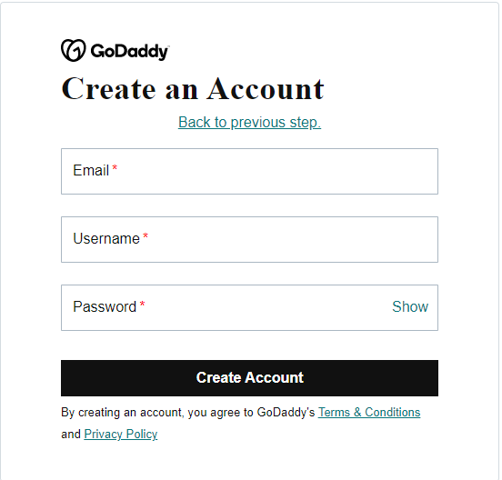
How to Signup GoDaddy.com ?
Steps to signup:
To begin the Signup process, go to https://sso.godaddy.com/
From the top, select the ‘Create an Account’ option.
We can signup by using Facebook, Gmail, Email etc.
Then next ( Using Email Option), Complete the onscreen fields like Email, Username and Password.
Finally, press ‘Create Account’ and wait for the setting to complete.

Slide 4
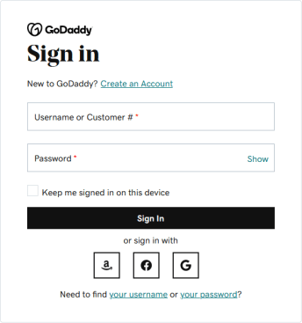
Steps to signing in:
For the sign in process, go to https://sso.godaddy.com/
Enter the fields, ‘Username’ and ‘Password’.
Click on “Sign In”, then you will redirect to the dashboard of GoDaddy account.

Slide 5
Other Web hosting and Domain registrar sites:
Bluehost
Freenom
Domain.com
SiteGround
HostGator
DreamHost

Slide 6
Thank You

